Slide 1
Correspondences between protein sequence and structure
Basic concepts | 10 min
- Sequence-structure relationship
Protein folding prediction Intrinsic disorder prediction
Structure and disorder prediction | 15 min
Template-based structure prediction
- Intrinsically disordered regions prediction
Q&A | 5 min

Slide 2
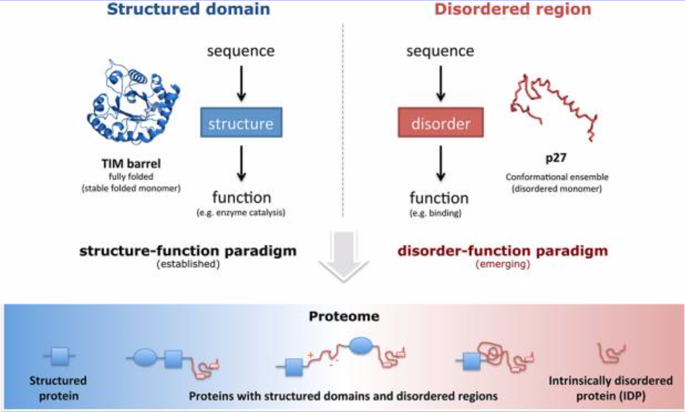
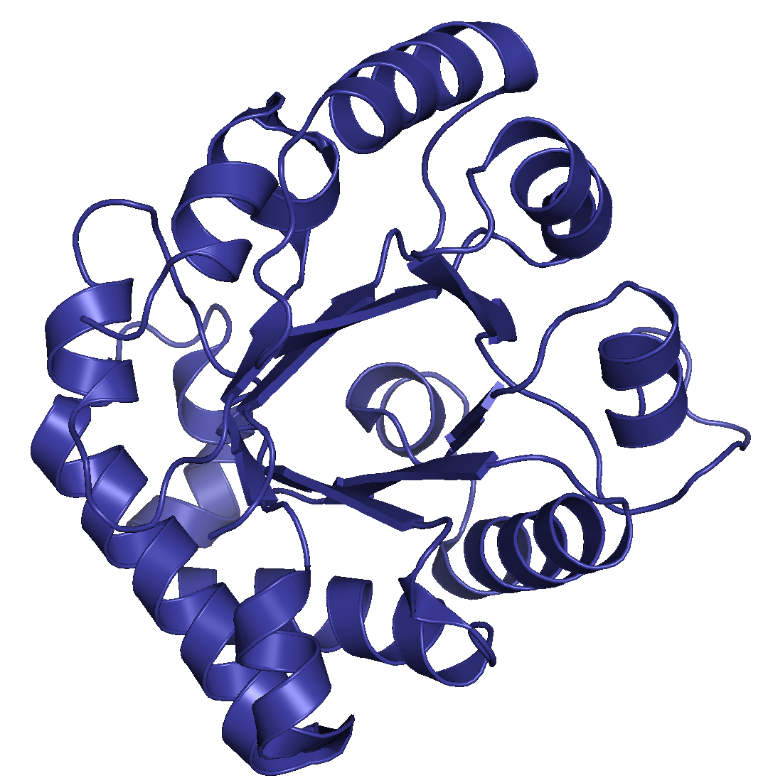
Sequence-structure relationship
In the 1960s, Christian Anfinsen postulated that the unique three-dimensional structure of a protein is determined by its amino acid sequence (sequence–structure–function paradigm). However, intrinsically disordered proteins and regions does not conform to this postulate. Disordered regions contribute to protein function and do not fold into a defined tertiary structure.
Babu M. The contribution of intrinsically disordered regions
to protein function, cellular complexity, and human
Disease. Biochemical Society Transactions. 2016. 44:1185–1200. doi: 10.1042/BST20160172
Adapted from van der Lee et al. Classification of Intrinsically Disordered Regions and Proteins. Chem. Rev. 2014. 114: 6589−6631. doi: 10.1021/cr400525m

Slide 3
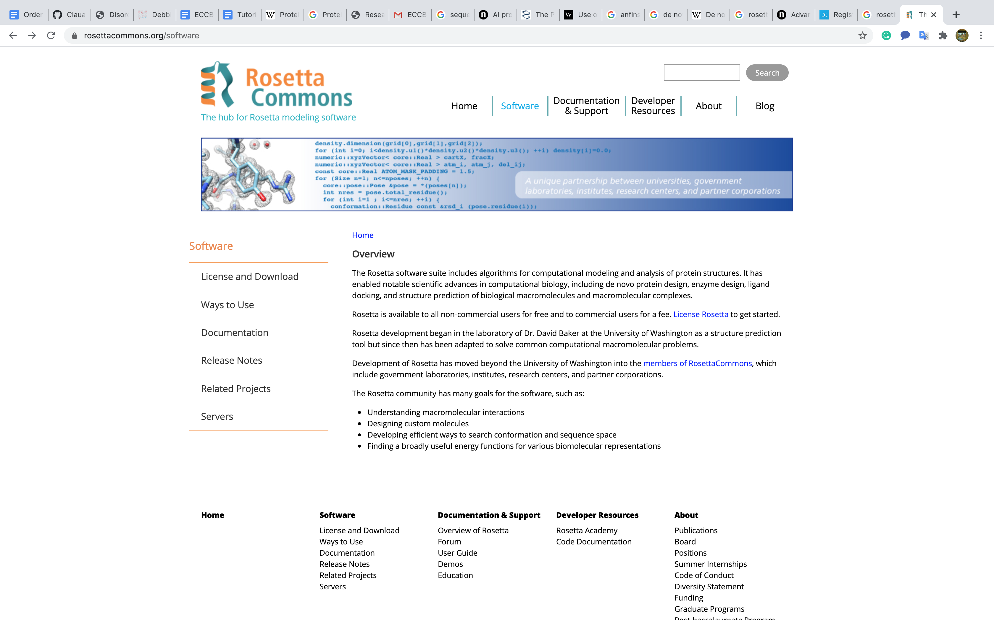
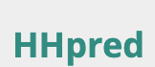
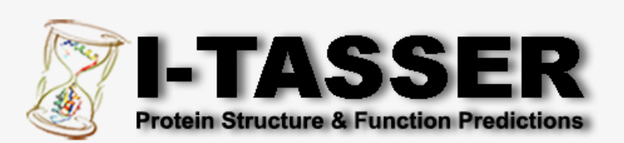
How can we predict protein folding?
Template-free (or de novo or ab initio)
Template-based (or homology-modeling)
They do not use any known structures. Useful when not a single structure in a protein family is known.
Use the similarity to another protein whose three-dimensional structure is known.
PDB ID: 1R2T Triose-phosphate isomerase (TIM). Aparicio R, Ferreira S, Polikarpov I. J Mol Biol. 2003. 334: 1023-1041. DOI: 10.1016/j.jmb.2003.10.022
doi: 10.1016/S0076-6879(04)83004-0
doi: 10.1093/nar/gki408
doi: 10.1093/nar/gkv342
Kuhlman B, Bradley P. Advances in protein structure prediction and design. Nature Reviews Molecular Cell Biology. 2019. 20:681–697.

Slide 4
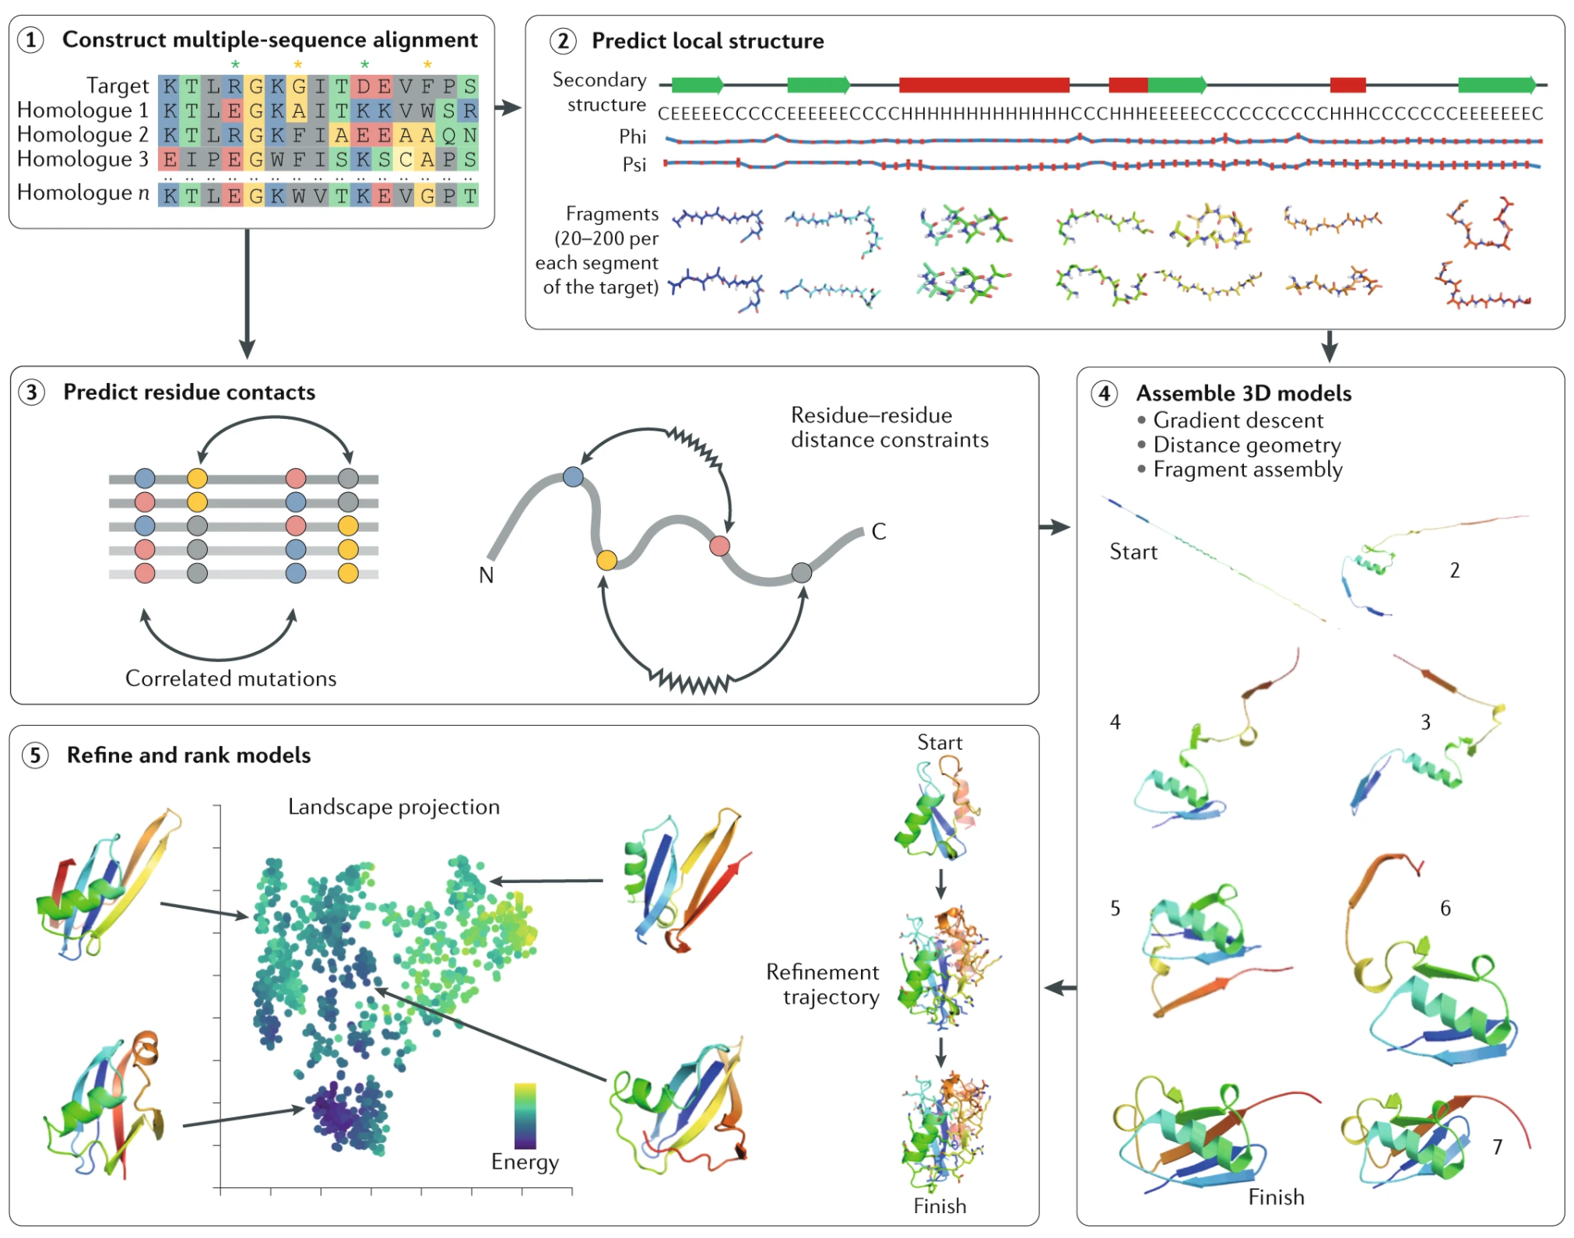
Template-free (de novo) folding prediction
Typically begins with the construction of a multiple-sequence alignment of the target protein and related sequences. The sequences of the target and its homologues are then used to predict local structural features, such as secondary structure and backbone torsion angles, and non-local features, such as residue–residue contacts or inter-residue distances across the polypeptide chain. These predicted features guide the process of building 3D models of the target protein structure, which are then refined, ranked and compared with one another to select the final predictions.
Kuhlman B, Bradley P. Advances in protein structure prediction and design. Nature Reviews Molecular Cell Biology. 2019. 20:681–697.

Slide 5
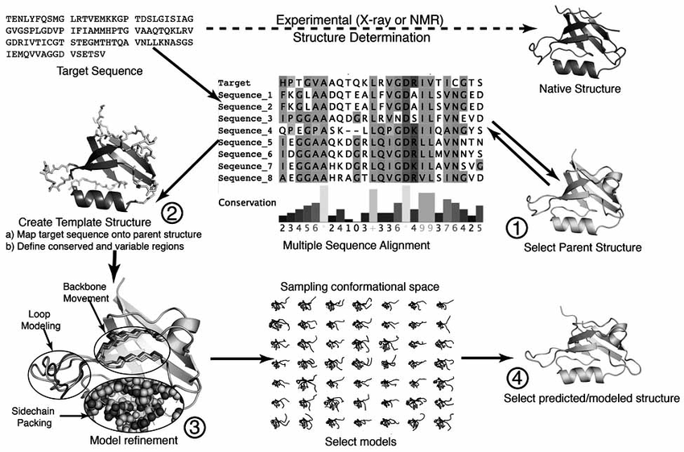
Template-based (or homology model building)
The steps in standard template-based modelling include selection of a suitable structural template; alignment of the target sequence to the template structure; and molecular modelling to account for mutations, insertions and deletions present in the target–template alignment.
Together with available crystal structures, template-based modelling approaches can provide structural information for roughly two-thirds of known protein families.
Kuhlman B, Bradley P. Advances in protein structure prediction and design. Nature Reviews Molecular Cell Biology. 2019. 20:681–697.
Xiaotao Q, Rosemarie S, Ryan D, Jerry Ti. A Guide to Template Based Structure Prediction. Current Protein & Peptide Science. 2009. 10:270-285. doi: : 10.2174/138920309788452182

Slide 6
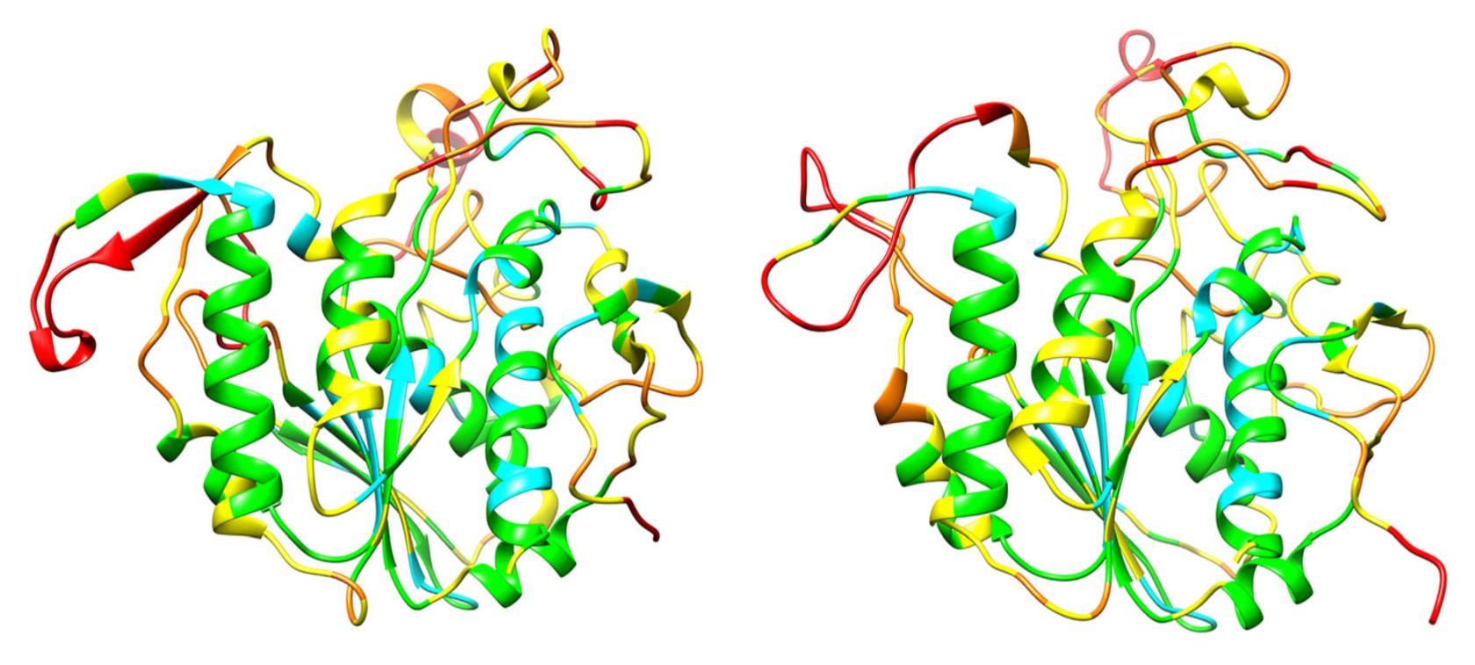
CASP (Critical Assessment of Structure Prediction)
Created in 1994, CASP is a community wide experiment to determine and advance the state of the art in modeling protein structure from amino acid sequence.
The most recent CASP13 (2018) saw a dramatic progress in template-free modeling by using deep learning techniques to predict inter-residue distances. With the proviso that there are an adequate number of sequences known for the protein family, the new methods essentially solve the long-standing problem of predicting the fold topology of monomeric proteins.
X-ray structure of Xylan acetyltransferase (unknown for the participants in CASP)
Most accurate CASP model by template-free modeling
Kryshtafovych A, Schwede T, Topf M, Fidelis K, Moult J. Critical assessment of methods of protein structure prediction (CASP)—Round XIII. 2019. doi:10.1002/prot.25823.

Slide 7
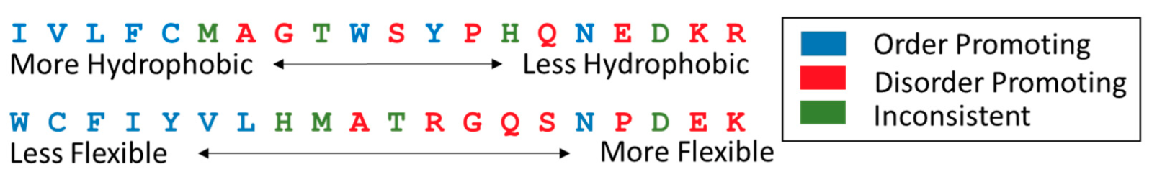
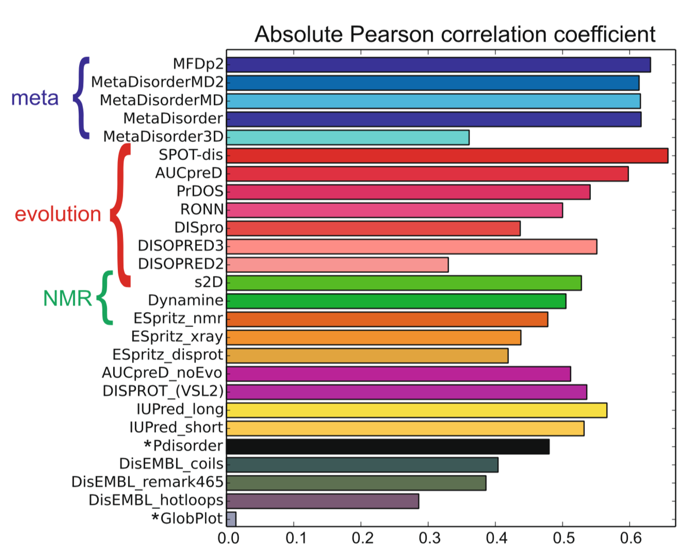
Intrinsic Disorder Prediction
The distinct sequence features that are present in IDPs and IDRs allow the construction of sequence based rules that can facilitate high performance disorder prediction.
DeForte S, Uversky V. Order, Disorder, and Everything in Between. Molecules. 2016. 21,1090. doi:10.3390/molecules21081090.
Ranking of disorder prediction methods according to the absolute Pearson linear correlation coefficient between estimated disorder probability and Z-score.
Nielsen J, Mulder F. Quality and bias of protein disorder
Predictors. Scientific Reports. .2019. 9:5137. doi.org/10.1038/s41598-019-41644-w

Slide 8
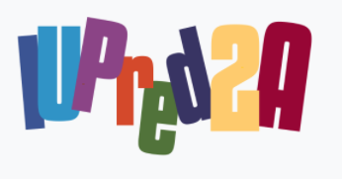
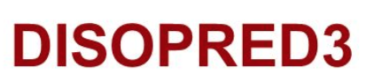

Strategies of Intrinsic Disorder Prediction
Three general prediction strategies currently exist:
Sequence properties | Estimation residue interaction energies. Sequences with lower predicted pairwise interaction energies are considered more likely to be disordered due to a lack of stabilizing contacts.
Machine learning | Use of training sets for machine learning. For instance: unresolved residues in X-ray structures; linear support vector machines (SVMs) trained on PSI-BLAST sequence profiles surrounding unresolved residues.
Meta-predictors | Combine several individually successful disorder prediction methods have been developed more recently, resulting in increases in prediction accuracy
doi:10.1093/nar/gky384
doi: 10.1093/bioinformatics/btu744
https://doi.org/10.1093/nar/gkx1071
van der Lee et al. Classification of Intrinsically Disordered Regions and Proteins. Chem. Rev. 2014. 114: 6589−6631. doi: 10.1021/cr400525m

Slide 9
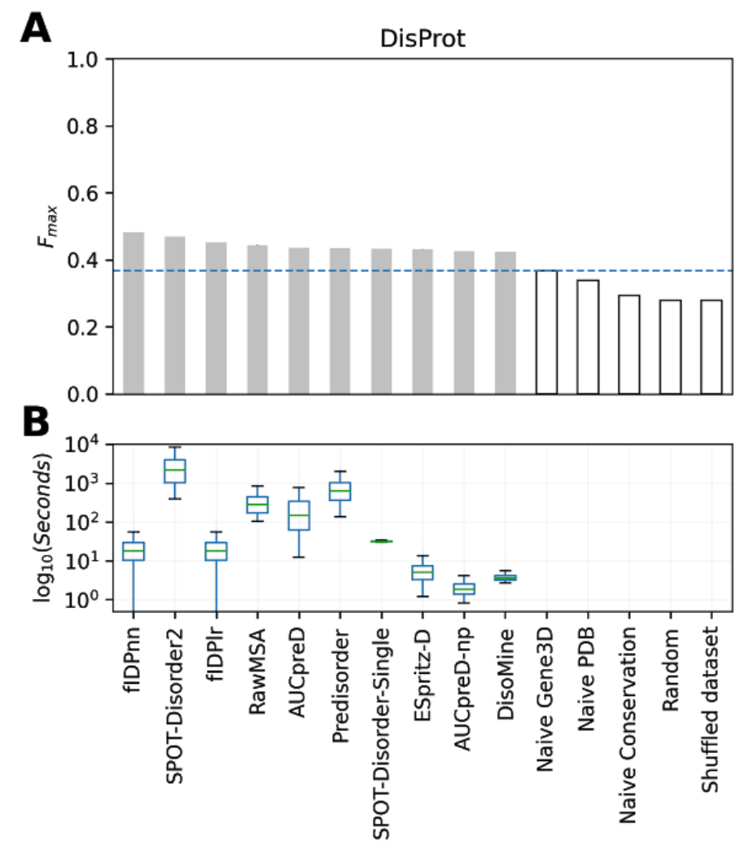
CAID (Critical Assessment of Intrinsic protein Disorder)
Created in 2018, CAID is a community wide experiment to determine and advance the state of the art in the detection of intrinsically disordered residues form the amino acid sequence.
CAID has two main prediction categories:
intrinsic structural disorder
binding sites found in IDRs (known as MoRFs, SLIMs or LIPs).
Necci M​, Piovesan D,​ CAID Predictors ​, DisProt Curators ​. Tosatto S. Critical Assessment of Protein Intrinsic Disorder Prediction. doi:10.1101/2020.08.11.245852
Performance of predictors for the top ten best ranking methods (A) and the distribution of execution time per-target (B).
Adapted from Necci M​, Piovesan D,​ CAID Predictors ​, DisProt Curators ​. Tosatto S. Critical Assessment of Protein Intrinsic Disorder Prediction. doi:10.1101/2020.08.11.245852

